Slide 1

Financial Behavior Trends
By: Kevin Tracy, Sahil Shamim, Saiful Alam, Sarvad Lothe, Bharath

Slide 2
Business Context
Having a good credit mix is crucial to proper fiscal management throughout one's lifetime
This dataset analyzes a variety of factors such as consumer spending/investing trends, how factors vary by occupations, and the various effects having a good credit mix can have on one's portfolio.
Utilizing the power of tableau and the information this dataset provides, we intend to visually demonstrate the various effects of a credit mix.

Slide 3

Data Description
Source: Credit Score Classification Dataset https://www.kaggle.com/datasets/iremnurtokuroglu/credit-score-classification-cleaned-dataset
The Credit Score Classification Cleaned Dataset contains data on individuals' financial behaviors and credit scores which could be used to predict if a person is likely to default on a loan. It has variables such as Age, income, credit history, credit utilization ratio and more. This dataset provides a rich resource for exploring patterns and relationships in consumer financial data.

Slide 4
Data Description/Preparation
Age - How old an Individual is. Age is relevant for it is a good indicator of financial behavior, investment decisions and spending habits
Occupation - An Individuals job or Profession. Occupation is a great indicator that impacts income, and financial habits. Certain occupations may offer higher salaries and better stability.
Annual Income - The total amount of money an individual earns in one year before taxes. Higher annual income often provides greater financial flexibility. Income is often used to assess creditworthiness and financial stability.
Monthly Salary - Monthly salary of an Individual after taxes. This is a key metric to determine an individual's cash flow and ability to meet various financial obligations. Direct affects Credit Utilization and spending capacity and allows one to make an inference on payment as well as spending behavior
Credit History Age - How long a credit account has been open in months. A longer credit history can offer insights into past credit behavior and generally implies more experience with managing credit and could potentially be associated with lower credit utilization ratios.
Spending Behavior - The individual's patterns and tendencies relating to spending money. Understanding Spending behavior could shed light on how well an individual manages debt and credit. Excessive spending could lead to a higher credit utilization, while controlled spending is often linked to better credit management and overall financial health.
Bank Account Volume - How many bank accounts an individual has. This factor gives an indication of savings and overall liquidity. A higher number of bank accounts may indicate better financial management while a lower number may indicate potential issues with financial stability.
Credit Card Volume - How many credit card an individual holds. This is a key factor in assessing an individual's level of financial accessibility and capacity. A higher number of credit cards could suggest a higher credit utilization risk which would not only affect the ratio but also the credit score.
Loan Volume - How many outstanding loans an individual holds. A higher number of loans may indicate financial pressure of an overload of debt.
Credit Mix Standing - Credit mix is a measure of the diversification of credit accounts. A healthy Credit mix is important for maintaining a good credit score. Credit mix standing often reflects an individual's ability to manage credit.
Credit Utilization Ratio - The ratio of outstanding credit card balances to total available credit limit. This acts a key indicator of credit risk. A higher credit utilization ratio usually refers to an individual over-relying on credit. A lower ratio is typically seen as ideal for maintaining a healthy credit score
Monthly Investments - How much an individual invests in a month. This shows an individual’s approach to long term wealth building. A pattern of long-term monthly investments is usually linked as a sign of financial responsibility.
Payment Behavior - How large of a payment an individual typically makes in paying off debts and bills. This is a strong indicator of financial reliability

Slide 5
Research Questions
Kevin: Do individuals with an overall better credit mix have less debt on average?
Bharath: What is the average annual income based on different credit mixes?
Saiful: How do demographic factors influence payment behavior across different transaction values?
Sarvad: Is payment/spending behavior influenced by credit history age?
Sahil: How does Occupation and Spending Behaviour affect Investment Trends and Credit Utilization?

Slide 6
Methodologies
The group utilized a variety of visualization tools to demonstrate our research questions including:
Bar Chart
Area Chart
Line Chart
Stacked Bar Chart

Slide 7
Dashboard 1

Slide 8
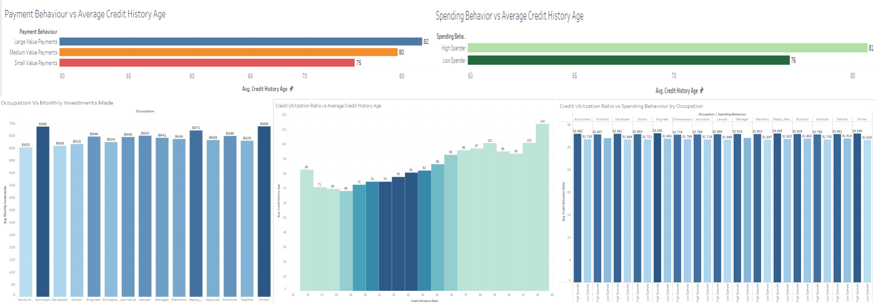
Dashboard 2

Slide 9
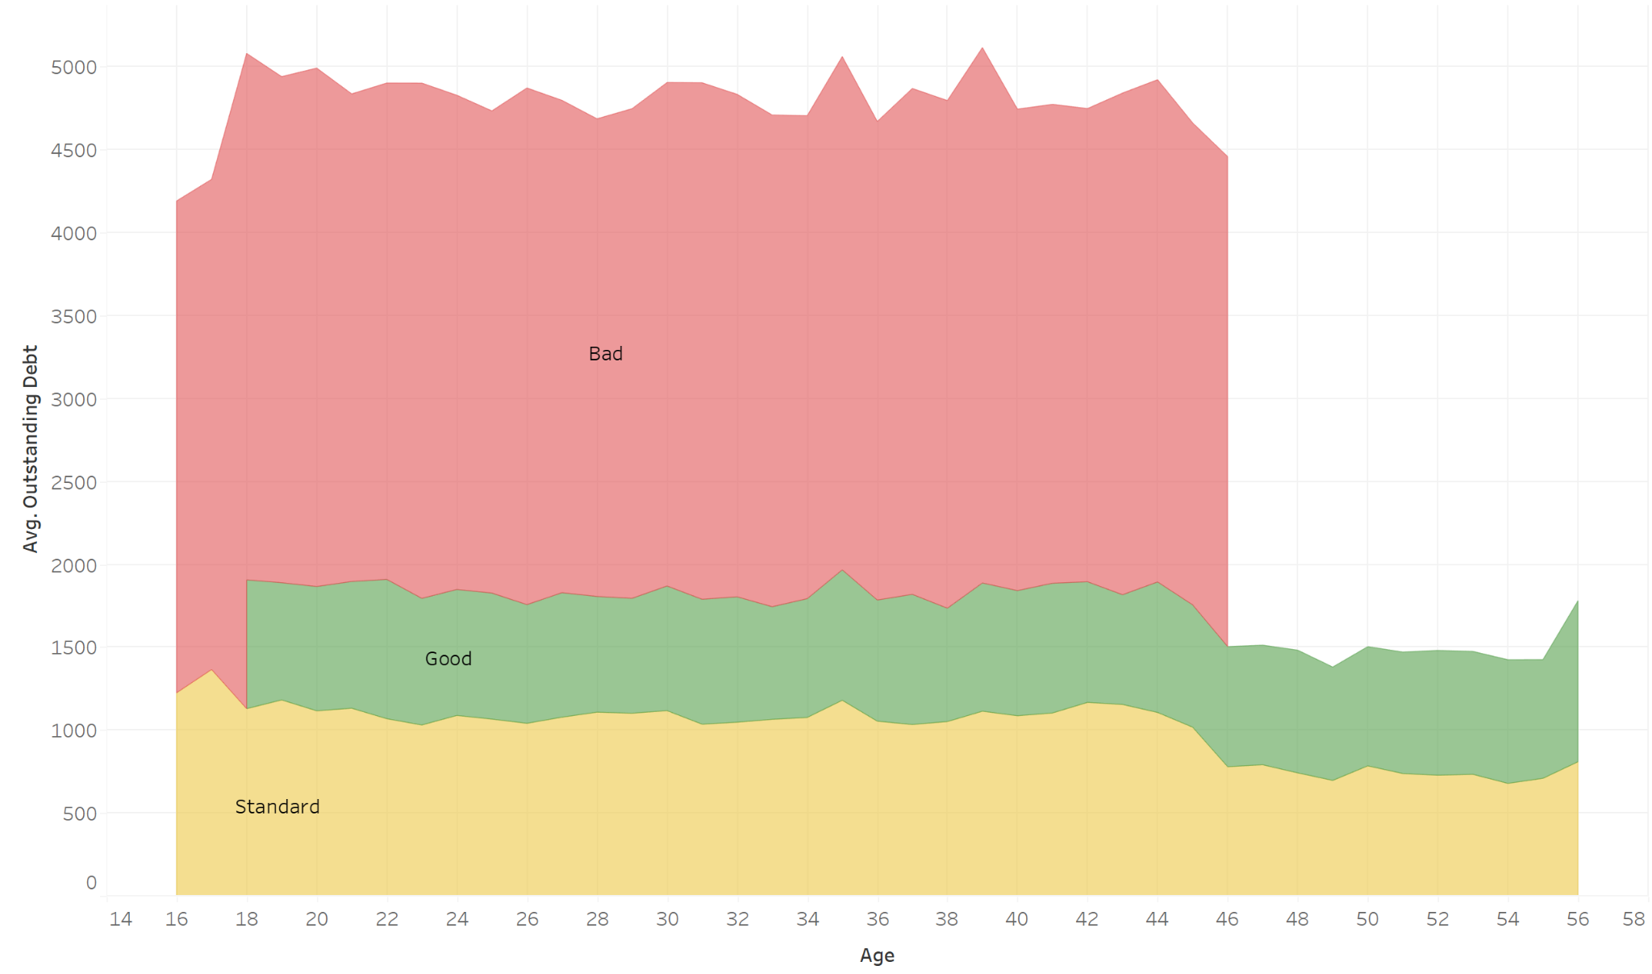

Kevin's Results
Having a poor credit mix almost always equates to having more outstanding debt throughout one's entire life.
It is important to note that those with the best credit mix typically have more outstanding debt than the standard, serving as a reminder that debt financing can help an overall portfolio when properly managed.

Slide 10
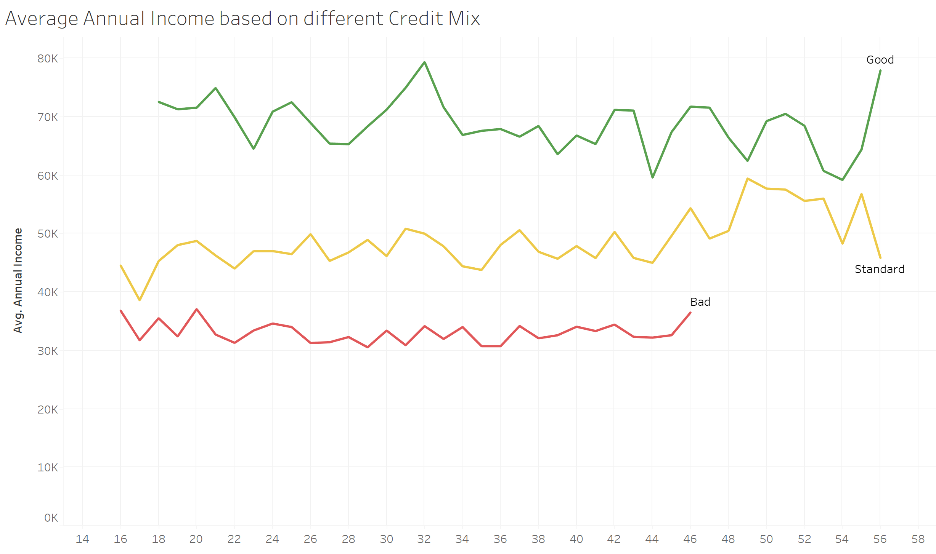
Bharath's Results
As it goes with most financial literacy, having a better credit mix will equate to a better average annual income.
It is important to note that these lines never overlap, showing that to cross into a higher annual income one must also improve their overall credit mix.

Slide 11
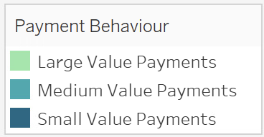
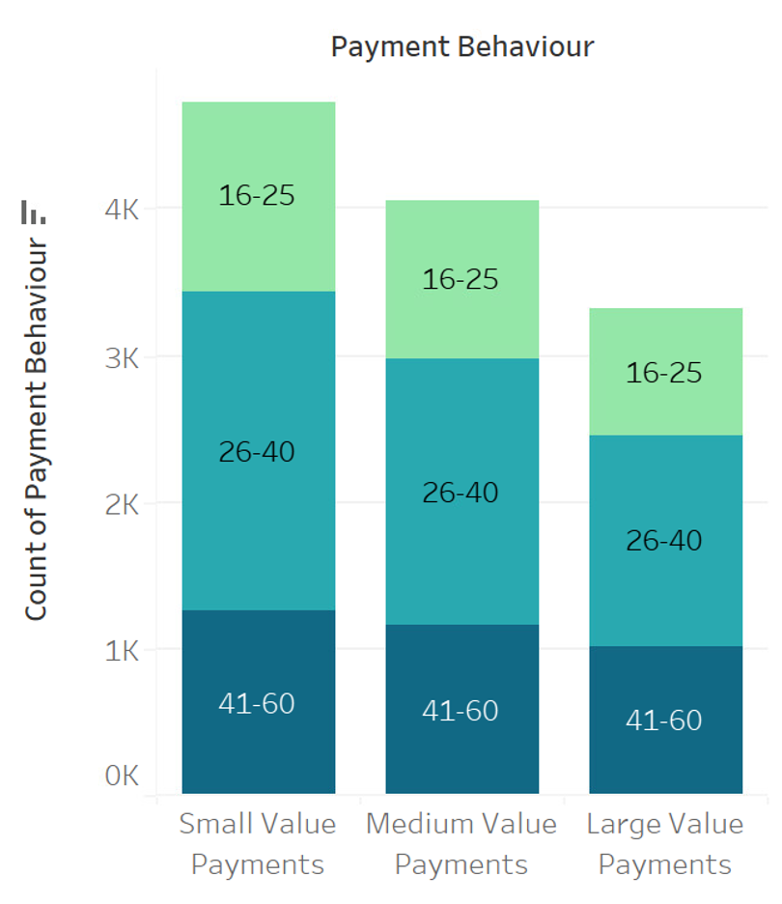
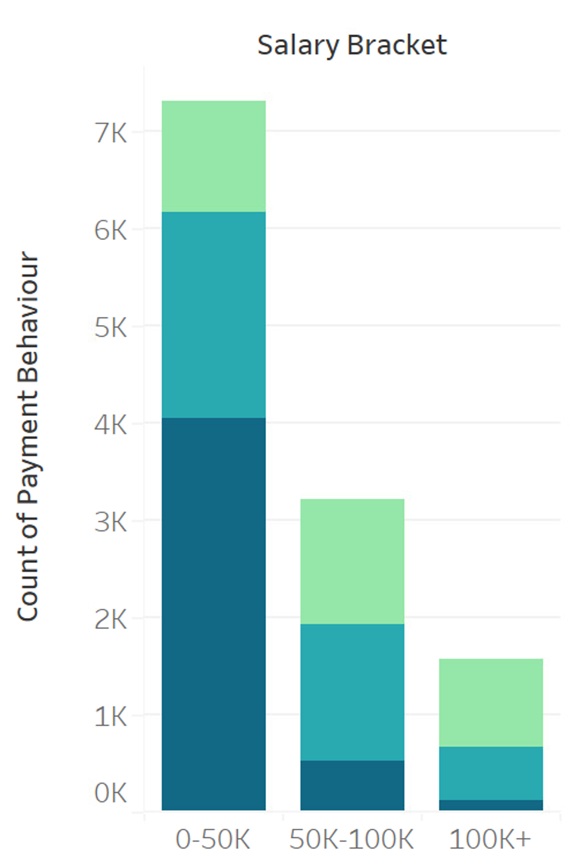
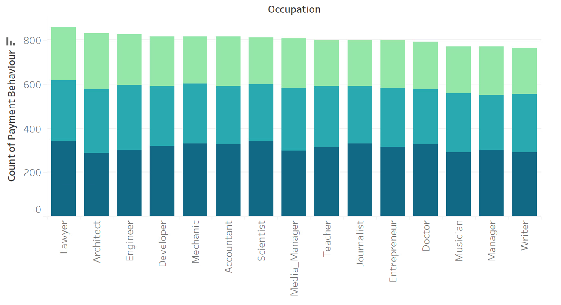
Saiful's Results
Across occupations, there is a relatively consistent distribution of transaction values.
Small-value transactions occur most frequently. The 26-40 age group exhibits the highest dominance across all transaction values, and the age distribution remains relatively consistent across transaction categories.
The majority of small value payments come from individuals in the lowest salary bracket, whereas higher salary brackets show a more balanced distribution between medium and large-value payments.

Slide 12
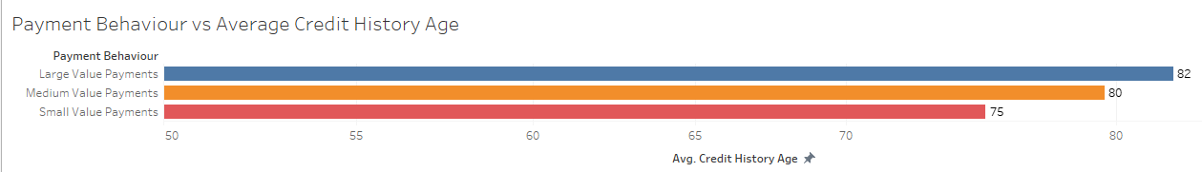
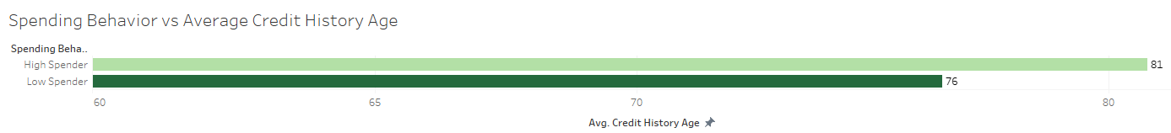
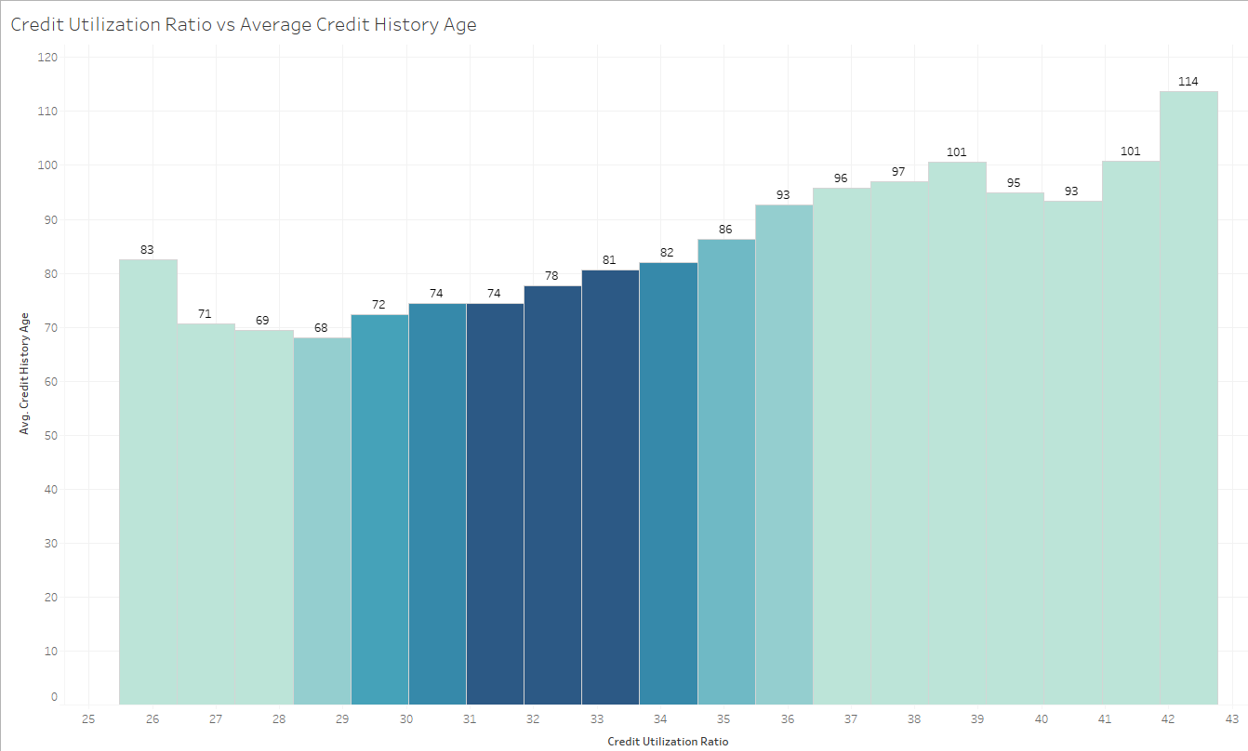
Sarvad's Results
As people’s credit history age increases, they are more likely to increase their payment and spending behaviors

Slide 13
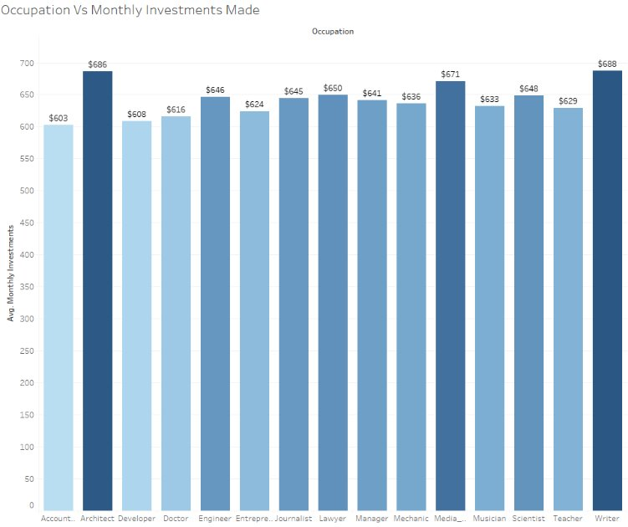
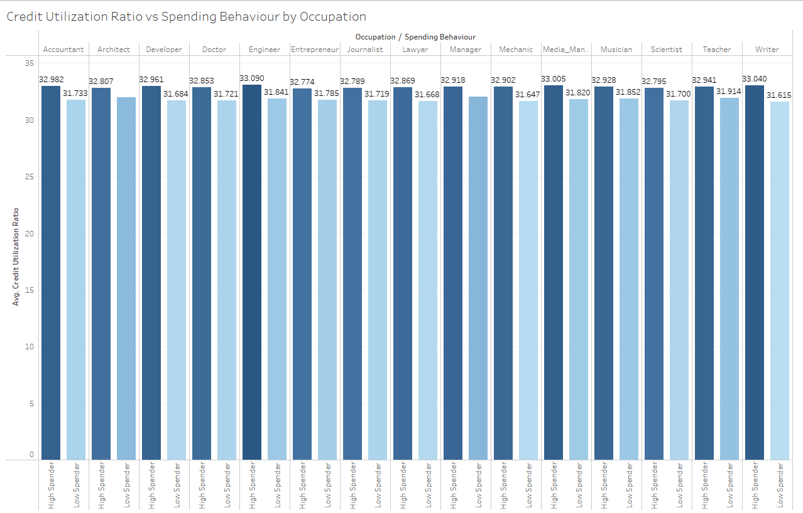
Sahil's Results
Occupation vs Monthly Investments Made: Visualization of how much each Occupation invests monthly.
Credit Utilization Ratio vs spending Behavior by Occupation: Visualizes how Credit Utilization Rato is affected by Spending Habits grouped by Occupation.
This means that the more one spends the higher the credit utilization ratio indicating a higher chance of credit risk.

Slide 14
Lessons Learned
Using colors (intensity, hue) to differentiate data can be crucial in pre-attentive processing, providing the viewer with instant information without having to do any manual deciphering.
Data can often be meaningless when in large quantities like this dataset, properly utilizing visualization can provide clear meaning to a variety of questions.
It is important to determine whether a factor is providing its full dimension, or if it is more beneficial to view an AVERAGE or SUM of the information.
Initial Research Questions often shape the important factors behind the overall analysis of the data.

